Slide 1
THE LIFE OF CHRIST

Slide 2
John 18:1 When Jesus had spoken these words, He went out with His disciples over the Brook Kidron, where there was a garden, which He and His disciples entered.
The Brook of Kidron is the name of a seasonal mountain stream and the valley through which it flows, between Jerusalem and the Mount of Olives on the east (Friberg).

Slide 3
Luke 22:39 Coming out, He went to the Mount of Olives, as He was accustomed, and His disciples also followed Him.

Slide 4
Friberg says the following about the garden: Gethsemane; strictly oil press; name of an olive orchard on the Mount of Olives overlooking Jerusalem from the east

Slide 5
The traditional spot of Gethsemane is less than a half mile directly east of the Golden Gate – a walled garden, seventy yards square, which contains seventy-five or so gnarled olive trees. Present-day guides claim that the olive trees are those under which Jesus prayed, but, according to ancient historians, all the trees were destroyed when Rome besieged and then destroyed Jerusalem. It is true, however, that the present trees are very, very old (p. 443 The Life of Christ).

Slide 6
Mark 14:32 Then they came to a place which was named Gethsemane; and He said to His disciples, "Sit here while I pray." ³³ And He took Peter, James, and John with Him, and He began to be troubled and deeply distressed. ³⁴ Then He said to them, "My soul is exceedingly sorrowful, even to death. Stay here and watch."

Slide 7
Mark 14:35 He went a little farther, and fell on the ground, and prayed that if it were possible, the hour might pass from Him. ³⁶ And He said, "Abba, Father, all things are possible for You. Take this cup away from Me; nevertheless, not what I will, but what You will."

Slide 8
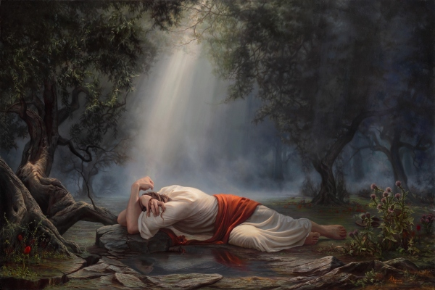

Slide 9
Isaiah 53:3 He is despised and rejected by men, A Man of sorrows and acquainted with grief. And we hid, as it were, our faces from Him; He was despised, and we did not esteem Him. ⁴ Surely He has borne our griefs And carried our sorrows; Yet we esteemed Him stricken, Smitten by God, and afflicted. ⁵ But He was wounded for our transgressions, He was bruised for our iniquities; The chastisement for our peace was upon Him, And by His stripes we are healed.

Slide 10
Hebrews 5:7 who, in the days of His flesh, when He had offered up prayers and supplications, with vehement cries and tears to Him who was able to save Him from death, and was heard because of His godly fear, ⁸ though He was a Son, yet He learned obedience by the things which He suffered. ⁹ And having been perfected, He became the author of eternal salvation to all who obey Him,

Slide 11
Philippians 4:11 Not that I speak in regard to need, for I have learned in whatever state I am, to be content: ¹² I know how to be abased, and I know how to abound. Everywhere and in all things I have learned both to be full and to be hungry, both to abound and to suffer need. ¹³ I can do all things through Christ¹ who strengthens me.

Slide 12
Mark 14:37 Then He came and found them sleeping, and said to Peter, "Simon, are you sleeping? Could you not watch one hour? ³⁸ "Watch and pray, lest you enter into temptation. The spirit indeed is willing, but the flesh is weak." ³⁹ Again He went away and prayed, and spoke the same words. ⁴⁰ And when He returned, He found them asleep again, for their eyes were heavy; and they did not know what to answer Him. ⁴¹ Then He came the third time and said to them, "Are you still sleeping and resting? It is enough! The hour has come; behold, the Son of Man is being betrayed into the hands of sinners. ⁴² "Rise, let us be going. See, My betrayer is at hand."

Slide 13
Luke 22:43 Then an angel appeared to Him from heaven, strengthening Him. ⁴⁴ And being in agony, He prayed more earnestly. Then His sweat became like great drops of blood falling down to the ground. ⁴⁵ When He rose up from prayer, and had come to His disciples, He found them sleeping from sorrow.

Slide 14
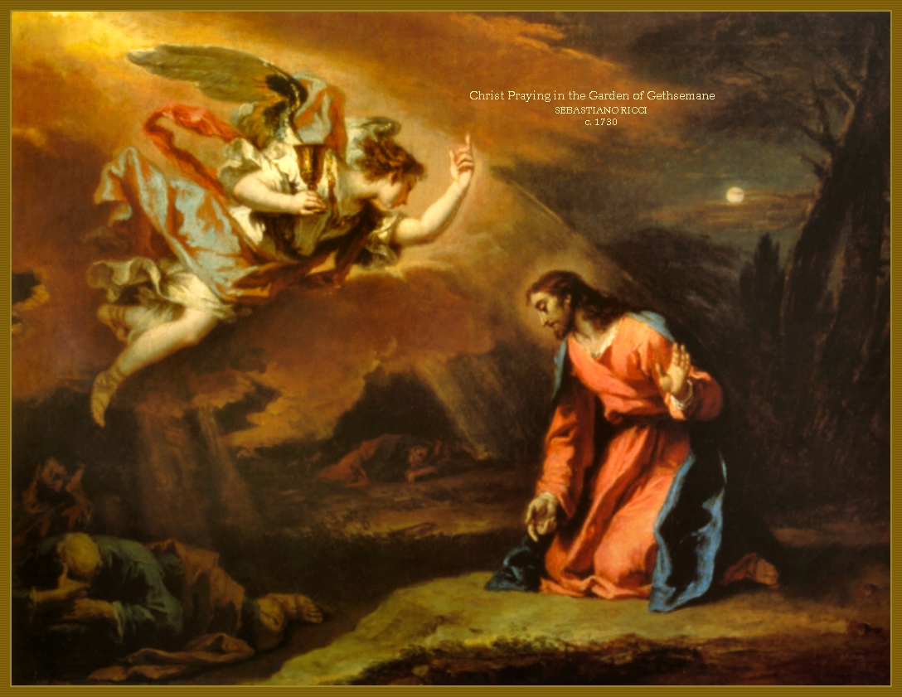

Slide 15
Luke has added that he found “them sleeping” for sorrow – that is, “on account” of their sorrow; or their grief was so great that they naturally fell asleep. Multitudes of facts might be brought to show that this is in accordance with the regular effects of grief. Dr. Rush says: “There is another symptom of grief, which is not often noticed, and that is “profound sleep.” I have often witnessed in mothers, immediately after the death of a child. Criminals, we are told my Mr. Akerman, the keeper of Newgate, in London, often sleep soundly the night before their execution. The son of General Custine slept 9 hours the night before he was led to the guillotine in Paris.” Diseases of the Mind, p. 319.

Slide 16
⁴¹ Then He came the third time and said to them, "Are you still sleeping and resting? It is enough! The hour has come; behold, the Son of Man is being betrayed into the hands of sinners. ⁴² "Rise, let us be going. See, My betrayer is at hand."

Slide 17
John 18:2 And Judas, who betrayed Him, also knew the place; for Jesus often met there with His disciples. ³ Then Judas, having received a detachment of troops, and officers from the chief priests and Pharisees, came there with lanterns, torches, and weapons.

Slide 18
Mark 14:43 And immediately, while He was still speaking, Judas, one of the twelve, with a great multitude with swords and clubs, came from the chief priests and the scribes and the elders. ⁴⁴ Now His betrayer had given them a signal, saying, "Whomever I kiss, He is the One; seize Him and lead Him away safely." ⁴⁵ As soon as He had come, immediately he went up to Him and said to Him, "Rabbi, Rabbi!" and kissed Him.

Slide 19
Luke 22:48 But Jesus said to him, "Judas, are you betraying the Son of Man with a kiss?"

Slide 20
John 18:4 Jesus therefore, knowing all things that would come upon Him, went forward and said to them, "Whom are you seeking?" ⁵ They answered Him, "Jesus of Nazareth." Jesus said to them, "I am He." And Judas, who betrayed Him, also stood with them. ⁶ Now when He said to them, "I am He," they drew back and fell to the ground. ⁷ Then He asked them again, "Whom are you seeking?" And they said, "Jesus of Nazareth." ⁸ Jesus answered, "I have told you that I am He. Therefore, if you seek Me, let these go their way," ⁹ that the saying might be fulfilled which He spoke, "Of those whom You gave Me I have lost none."

Slide 21
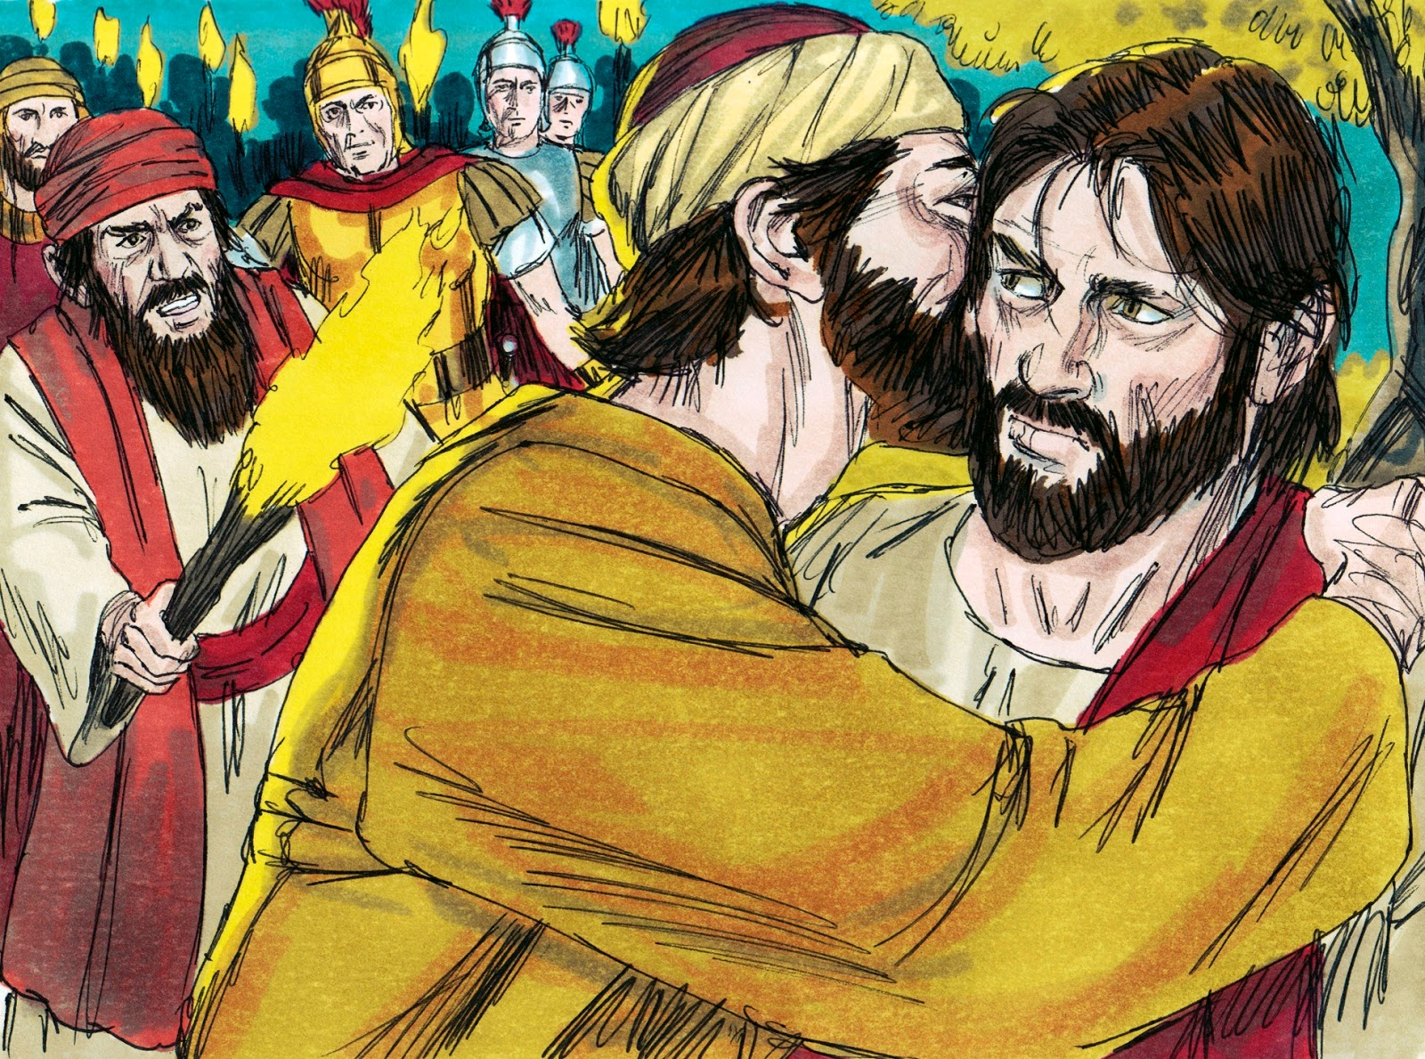

Slide 22
Matthew 26:50 But Jesus said to him, "Friend, why have you come?" Then they came and laid hands on Jesus and took Him.

Slide 23
Luke 22:49 When those around Him saw what was going to happen, they said to Him, "Lord, shall we strike with the sword?" ⁵⁰ And one of them struck the servant of the high priest and cut off his right ear. ⁵¹ But Jesus answered and said, "Permit even this." And He touched his ear and healed him.

Slide 24
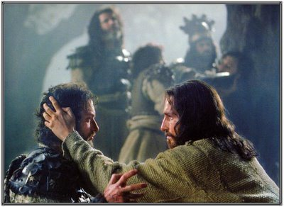
John 18:10 Then Simon Peter, having a sword, drew it and struck the high priest's servant, and cut off his right ear. The servant's name was Malchus. ¹¹ So Jesus said to Peter, "Put your sword into the sheath. Shall I not drink the cup which My Father has given Me?"

Slide 25
“Get behind Me, Satan! You are an offense to Me, for you are not mindful of the things of God, but the things of men” (Mt. 16:23).

Slide 26
“For the kingdom of God is not eating and drinking, but righteousness and peace and joy in the Holy Spirit” (Rom. 14:17).

Slide 27
Matthew 26:52 But Jesus said to him, "Put your sword in its place, for all who take the sword will perish by the sword. ⁵³ "Or do you think that I cannot now pray to My Father, and He will provide Me with more than twelve legions of angels? ⁵⁴ "How then could the Scriptures be fulfilled, that it must happen thus?" ⁵⁵ In that hour Jesus said to the multitudes, "Have you come out, as against a robber, with swords and clubs to take Me? I sat daily with you, teaching in the temple, and you did not seize Me. ⁵⁶ "But all this was done that the Scriptures of the prophets might be fulfilled." Then all the disciples forsook Him and fled.

Slide 28
Luke 22:53 "When I was with you daily in the temple, you did not try to seize Me. But this is your hour, and the power of darkness."

Slide 29
Mark 14:51 Now a certain young man followed Him, having a linen cloth thrown around his naked body. And the young men laid hold of him, ⁵² and he left the linen cloth and fled from them naked.

Slide 30
Jn. 18:12 Then the detachment of troops and the captain and the officers of the Jews arrested Jesus and bound Him. ¹³ And they led Him away to Annas first, for he was the father-in-law of Caiaphas who was high priest that year. ¹⁴ Now it was Caiaphas who advised the Jews that it was expedient that one man should die for the people.

Slide 31
According to the Mosaic law, the High Priest was the most important member of the believing community because he was the only one authorized by God to offer sacrifices for the sins of the community on the Day of Atonement (Exo. 30:10; Lev 16). This office was held by a descendant of Aaron and was passed on from father to son (cf. Exo. 28:1; Num. 18:1; 20:25-28). During King Herod's rule, however, the traditional pattern was often ignored as Herod arbitrarily dismissed and replaced the High Priest (Josephus Antiquities 15.51).

Slide 32
From then on, and continuing during Roman rule, the office ceased to be lifelong and hereditary. The office of High Priest became wholly dependent on political authority. But because the office of High Priest was lifelong, the High Priest retained a good measure of power and prestige among the Jewish population even after removal from office. This provides some background for the situation reflected in John 18:13 where two men are regarded as having the authority of the High Priest. Annas was appointed as High Priest in A.D. 6 by Quirinius,

Slide 33
governor of Syria, and was deposed nine years later by Valerius Gratus, prefect of Judea (Josephus Antiquities 18.26, 34, 95). Annas was succeeded by Ishmael ben Phiabia I (about A.D. 15-16) and then by Annas' son Eleazar (about A.D. 16-17). Following the term of Simon, son of Kamithos (A.D. 17-18), Joseph Caiaphas, who had married the daughter of Annas, was appointed to the office in A.D. 18 by Valerius Gratus. Caiaphas held the office until A.D. 36, when both Pilate and Caiaphas were removed from their respective offices by Lucius Vitellius, governor of Syria (Josephus Antiquities 18.89, 95) (J. Carl Laney, Moody Gospel of John Commentary (Chicago: Moody Press, 1992), p. 318).

